Slide 1
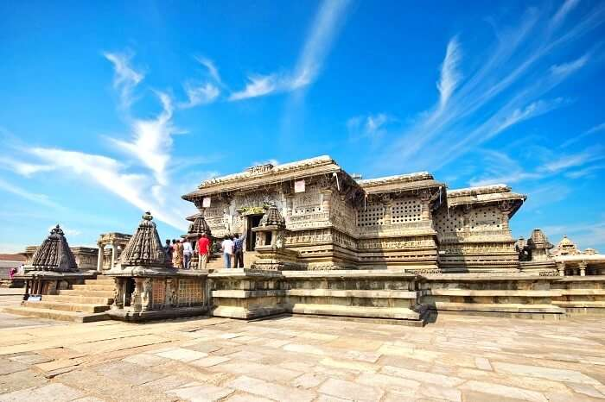
Indian Traditional Knowledge – 18LEM109T
Presentation on “Architecture Difference on North & South Temples” By – Kunal Keshan – RA2011004010051 – ECE A
Notes:
NOTE:
To change the image on this slide, select the picture and delete it. Then click the Pictures icon in the placeholder to insert your own image.

Slide 2
Introduction
Temple architecture in India has a rich and diverse history, with different regions and periods contributing to the unique styles seen today.
The North and South of India have distinctive architectural traditions that reflect their cultural and historical differences.
Hinduism, Buddhism, and Jainism have all influenced temple architecture in India, resulting in a variety of styles and motifs.
The intricate carvings, sculptures, and paintings found in Indian temples demonstrate the skill and creativity of the craftsmen who built them.
The temple is not just a place of worship, but also an embodiment of art, culture, and heritage that continues to inspire and fascinate people around the world.

Slide 3
North Indian Temple Architecture
Nagara Style: This style is characterized by a tall and curvilinear shikhara (tower) over the sanctum, with multiple projections and miniature shrines. Examples include the Kandariya Mahadeva Temple in Khajuraho and the Jagdish Temple in Udaipur.
Indo-Islamic Influence: During the Mughal period, Islamic architectural elements such as domes and arches were incorporated into North Indian temples, creating a unique blend of Hindu and Islamic styles. The Taj Mahal in Agra is a prime example of this fusion.
Mandapa: North Indian temples typically feature an open pavilion called a mandapa, which is used for community gatherings, music and dance performances, and other events. The Rangji Temple in Pushkar has a particularly impressive mandapa.
Ornamentation: North Indian temples are often highly decorated, with intricate carvings and sculptures depicting deities, animals, and other figures. The Konark Sun Temple in Odisha is famous for its elaborate stone carvings.
Water Features: Many North Indian temples feature water elements such as pools, fountains, and tanks, which are believed to have purifying and healing properties. The Abhaneri Stepwell in Rajasthan is a stunning example of a temple water feature.

Slide 4
South Indian Temple Architecture
South Indian temple architecture is characterized by a unique style of temple construction, which is distinct from the North Indian temple architecture.
The temples in South India are usually built with granite stone, which is locally available and is known for its durability.
The temples typically have a large tower or gopuram at the entrance, which is often decorated with intricate carvings and sculptures.
The inner sanctum of the temple, where the main deity is kept, is typically smaller than the outer structures and is surrounded by a pillared hall or mandapa.
Some of the famous examples of South Indian temple architecture include the Brihadeeswarar Temple in Thanjavur, Meenakshi Temple in Madurai, and the Padmanabhaswamy Temple in Thiruvananthapuram.

Slide 5
Differences between North and South Indian Temple Architecture
The North Indian temples are usually built with sandstone and marble, while the South Indian temples are built with granite.
The North Indian temples often have multiple towers or shikharas, while the South Indian temples have a single large tower or gopuram.
The North Indian temple architecture is characterized by the use of arches and domes, while the South Indian temple architecture is characterized by the use of gopurams and mandapas.
The North Indian temples are often built on a raised platform, while the South Indian temples are built on a flat surface.
The North Indian temples usually have a larger central hall or garbhagriha, while the South Indian temples have a smaller inner sanctum surrounded by a pillared hall.

Slide 6
Influence of Temple Architecture on Indian Art and Culture
Temple architecture has had a profound influence on Indian art and culture, and has helped shape the country's rich cultural heritage.
The intricate carvings and sculptures on the temple walls and pillars have inspired many artists and craftsmen over the centuries.
The temple architecture has also influenced other forms of architecture in India, such as palace architecture and residential architecture.
The religious and spiritual significance of the temples has played an important role in shaping Indian society and culture.
The temples continue to be important centers of cultural and social activity in India, attracting millions of visitors every year.

Slide 7
Conclusion
North and South Indian temple architecture are two distinct styles of temple construction, each with its own unique features.
The temples have played an important role in shaping Indian art, culture, and society over the centuries.
Despite the differences between the two styles, both North and South Indian temples share a common goal of creating a sacred space where people can connect with the divine.
The temples continue to be important cultural and spiritual centers in India, attracting people from all over the world.
The rich cultural heritage of Indian temple architecture is a testament to the creativity, skill, and ingenuity of the Indian people, and serves as a source of inspiration for generations to come.

Slide 8
Thank You

